Slide 1
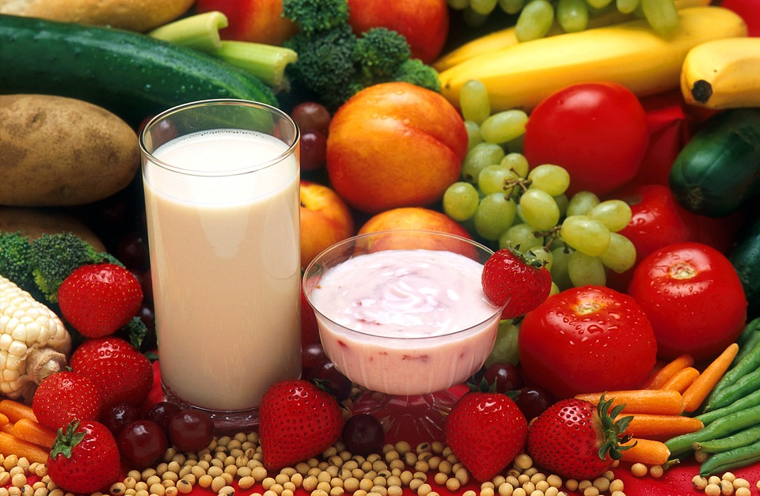
WINTER MENU 2017
FIRST & PRIMARY SCHOOL
WEEK ONE Homemade Items
 | Monday | Tuesday | Wednesday | Thursday | Friday
Main Course Choices
Potatoes Pasta/Rice
Vegetables | Seasonal Vegetables | Seasonal Vegetables | Seasonal Vegetables | Seasonal Vegetables | Seasonal Vegetables
Salad Bowl
Starters or Sweets
Homemade Pizza
Jacket Potato with a Choice of Fillings
Mince with Yorkshire Pudding
Jacket Potato with a Choice of Fillings
Roast of the Day with Yorkshire Pudding
Jacket Potato with a Choice of Fillings
Chicken Pie
Jacket Potato with a Choice of Fillings
Fish Portion
Jacket Potato with a Choice of Fillings
Garlic Bread
Crusty Bread
Jacket Potato Wedges or
Sweet Potato Wedges
Garlic Bread / Creamed Potato
Roast Potatoes or Creamed Potatoes or Parsley Potatoes
Creamed Potatoes
Parsley Potatoes
Chips or Pasta or
Mini Potato Waffles
Seasonal
Salad
Seasonal
Salad
Seasonal
Salad
Seasonal
Salad
Seasonal
Salad
Oaty Apple Crumble with Custard
Sticky Toffee Pudding with Custard
Fruity Rice Pudding
Chocolate & Mandarin Puddle Cake with Custard or Glass of Milk or Juice
Carrot Cake or Homemade Biscuit with a Glass of Milk
Fresh Fruit and Yoghurt available daily
Drinking Water is Available Daily on the Dining room Tables
Allergen Information is Available from the Catering Manager or NCC Web Site

Slide 2
WINTER MENU 2017
FIRST & PRIMARY SCHOOL
WEEK TWO Homemade Items
 | Monday | Tuesday | Wednesday | Thursday | Friday
Main Course Choices
Potatoes Pasta / Rice
Vegetables | Seasonal Vegetables | Seasonal Vegetables | Seasonal Vegetables | Seasonal Vegetables | Seasonal Vegetables
Salad Bar
Starters or Sweets
Fish Cakes
Jacket Potato with a Choice of Fillings
Curry of the Day
Jacket Potato with a Choice of Fillings
Roast of the Day with Yorkshire Pudding
Jacket Potato with a Choice of Fillings
Savoury Mince with Dumplings
Jacket Potato with a Choice of Fillings
Breaded Fish Portion
Jacket Potato with a Choice of Fillings
Crusty Bread
Jacket Potato Wedges
Basmati Rice
Couscous
Pasta
Roast Potatoes
Creamed Potatoes
Parsley Potatoes
Creamed Potatoes
Parsley Potatoes
Chips or Pasta or
Mini Potato Waffles
Seasonal
Salad
Seasonal
Salad
Seasonal
Salad
Seasonal
Salad
Seasonal
Salad
Fruity Flapjack Crumble with a Glass of Milk
Swirly Whirly Chocolate Cake with Custard
Banana & Pineapple Cake or Orange Cake with Custard or Glass of Milk or Juice
Berry Slice or Fruit Whip with Custard
Homemade Biscuit with a Glass of milk or juice
Fresh Fruit & Yoghurt available
Drinking Water is Available Daily on the Dining room Tables
Allergen Information is Available from the Catering Manager or NCC Web Site

Slide 3
WINTER MENU 2017
FIRST & PRIMARY SCHOOL
WEEK THREE Homemade Items
 | Monday | Tuesday | Wednesday | Thursday | Friday
Main Course Choices
Potatoes Pasta / Rice
Vegetables | Seasonal Vegetables | Seasonal Vegetables | Seasonal Vegetables | Seasonal Vegetables | Seasonal Vegetables
Salad Bar
Starters or Sweets
French Baguette Pizza or Tuna / Cheese Melt
Jacket Potato with a Choice of Fillings
Savoury Mince Pie
Jacket Potato with a Choice of Fillings
Roast of the Day with Yorkshire Pudding
Jacket Potato with a
Choice of Fillings
Sausage in Gravy with Yorkshire Pudding
Jacket Potato with a
Choice of Fillings
Fish Fingers
Jacket Potato with a Choice of Fillings
Crusty Bread
Jacket Potato Wedges
Creamed Potatoes
Parsley Potatoes
Roast Potatoes
Creamed Potatoes
Parsley Potatoes
Creamed Potatoes
Parsley Potatoes
Chips or Pasta or
Mini Potato Waffles
Seasonal Salad
Seasonal Salad
Seasonal Salad
Seasonal Salad
Seasonal Salad
Jam / Syrup Sponge with Custard or Glass of Milk or Juice
Fruity Flapjack with Custard or Glass of Milk or Juice
Chocolate Pudding / Cake with Chocolate Sauce
Apple Cake with Custard or Glass of Milk or Juice
Plain / Fruity / Chocolate Muffin with a Glass of Milk or Juice
Fresh Fruit & Yoghurt available daily
Drinking Water is Available Daily on the Dining room Tables
Allergen Information is Available from the Catering Manager or NCC Web Site

